Slide 1
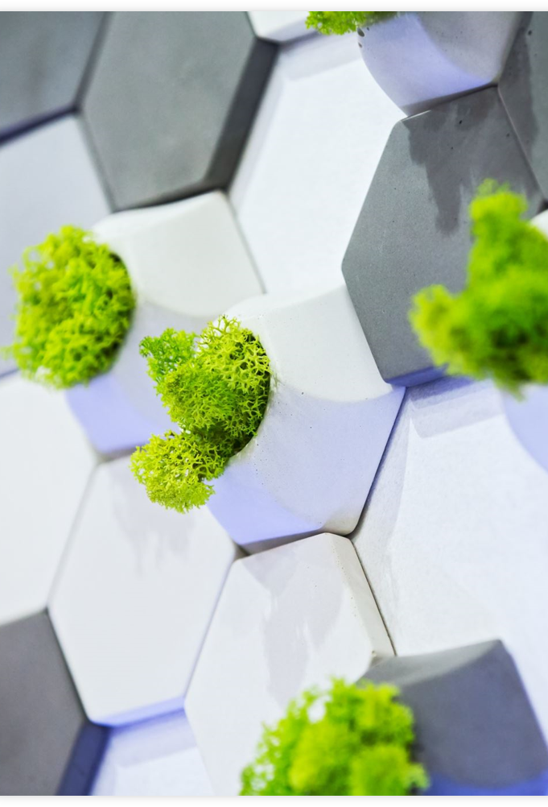
EGMT 5220: Smart Modular Indoor Farming Pods
Group 4
Danyelle Veillard | Shamsheer Hussain | Ashwini Mahadevaswamy |Mohit Athipedu | Madison Rogers
Notes:
Developed and organized a project that will help plant parents breath better both figuratively and literally! The intent of this project is to allow for Indoor farming made easy with an estimated budget of $5,000 and a time frame of 10-12 weeks.

Slide 2
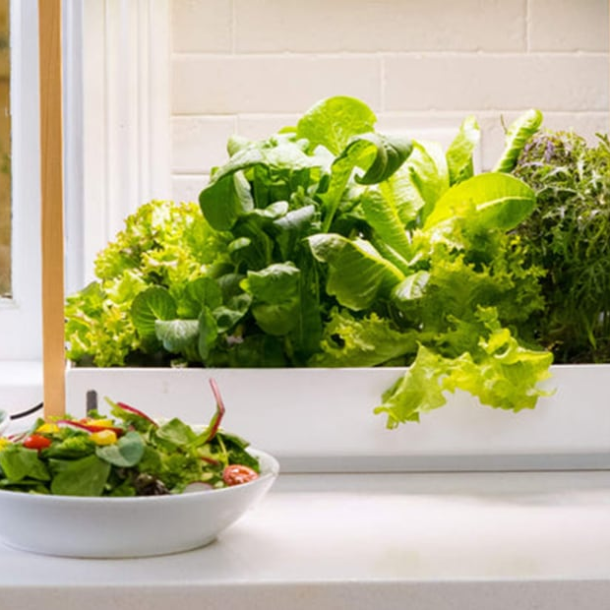
Project Objective
Prove a project plan for an indoor farming pod that enables urban residents to grow fresh herbs, greens, and small vegetables.
Design compact, modular pods, with simple IoT sensors (water, light, humidity)
Develop a companion mobile app for plant monitoring, health guidance, and harvest timing.
Complete research, design, and prototype mockups within 10-12 week timeline.
Notes:
Allow for homeowners to grow fresh produce, knowing that our modular pods take care of the grunt work. Water, light, humidity are densely researched and taken into account for care of one's plant. Homeowners can keep track of their seedling's growth through our companion mobile app and see the progress in connection with the pods.

Slide 3
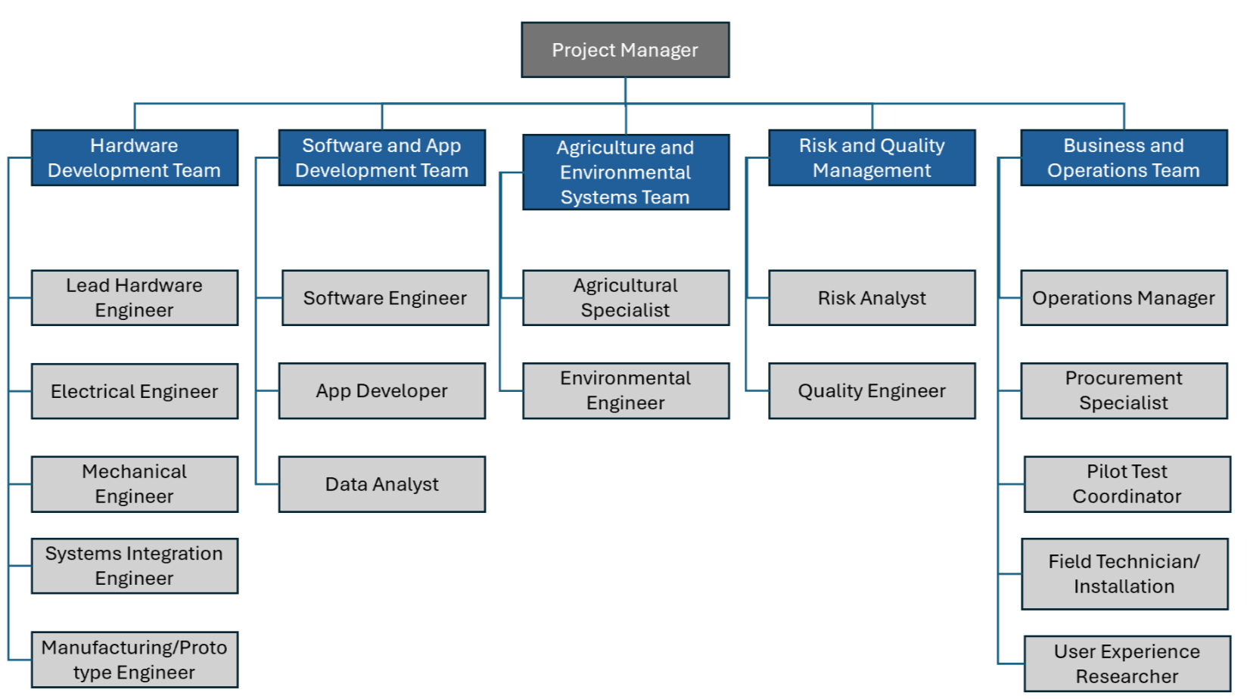
Project Organization
Supporting Tools:
WBS, Responsibility Chart, Gantt Chart
Shared documentation: OneDrive/Google Drive
PM Tools: Trello, MS Project
Notes:
Project Manager: Oversight, schedules, documentation, milestone tracking.
Hardware Lead: Sensor integration, pod structure, electronics.
Software Lead: App development, interface, integration testing.
QA Lead: Testing, validation, usability and performance checks.
Finance Lead: Budget monitoring, cost reporting.

Slide 4
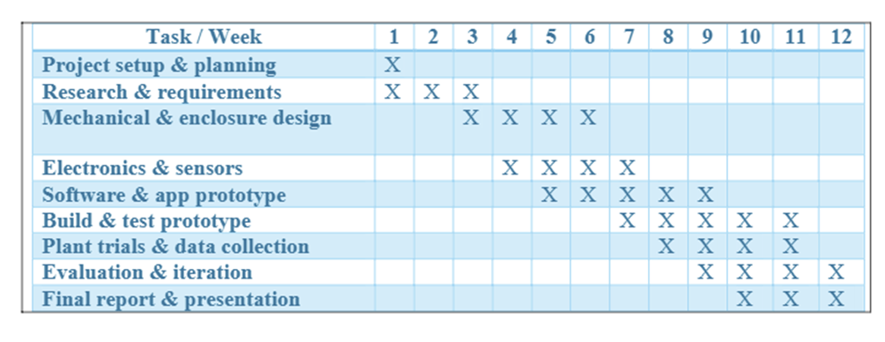
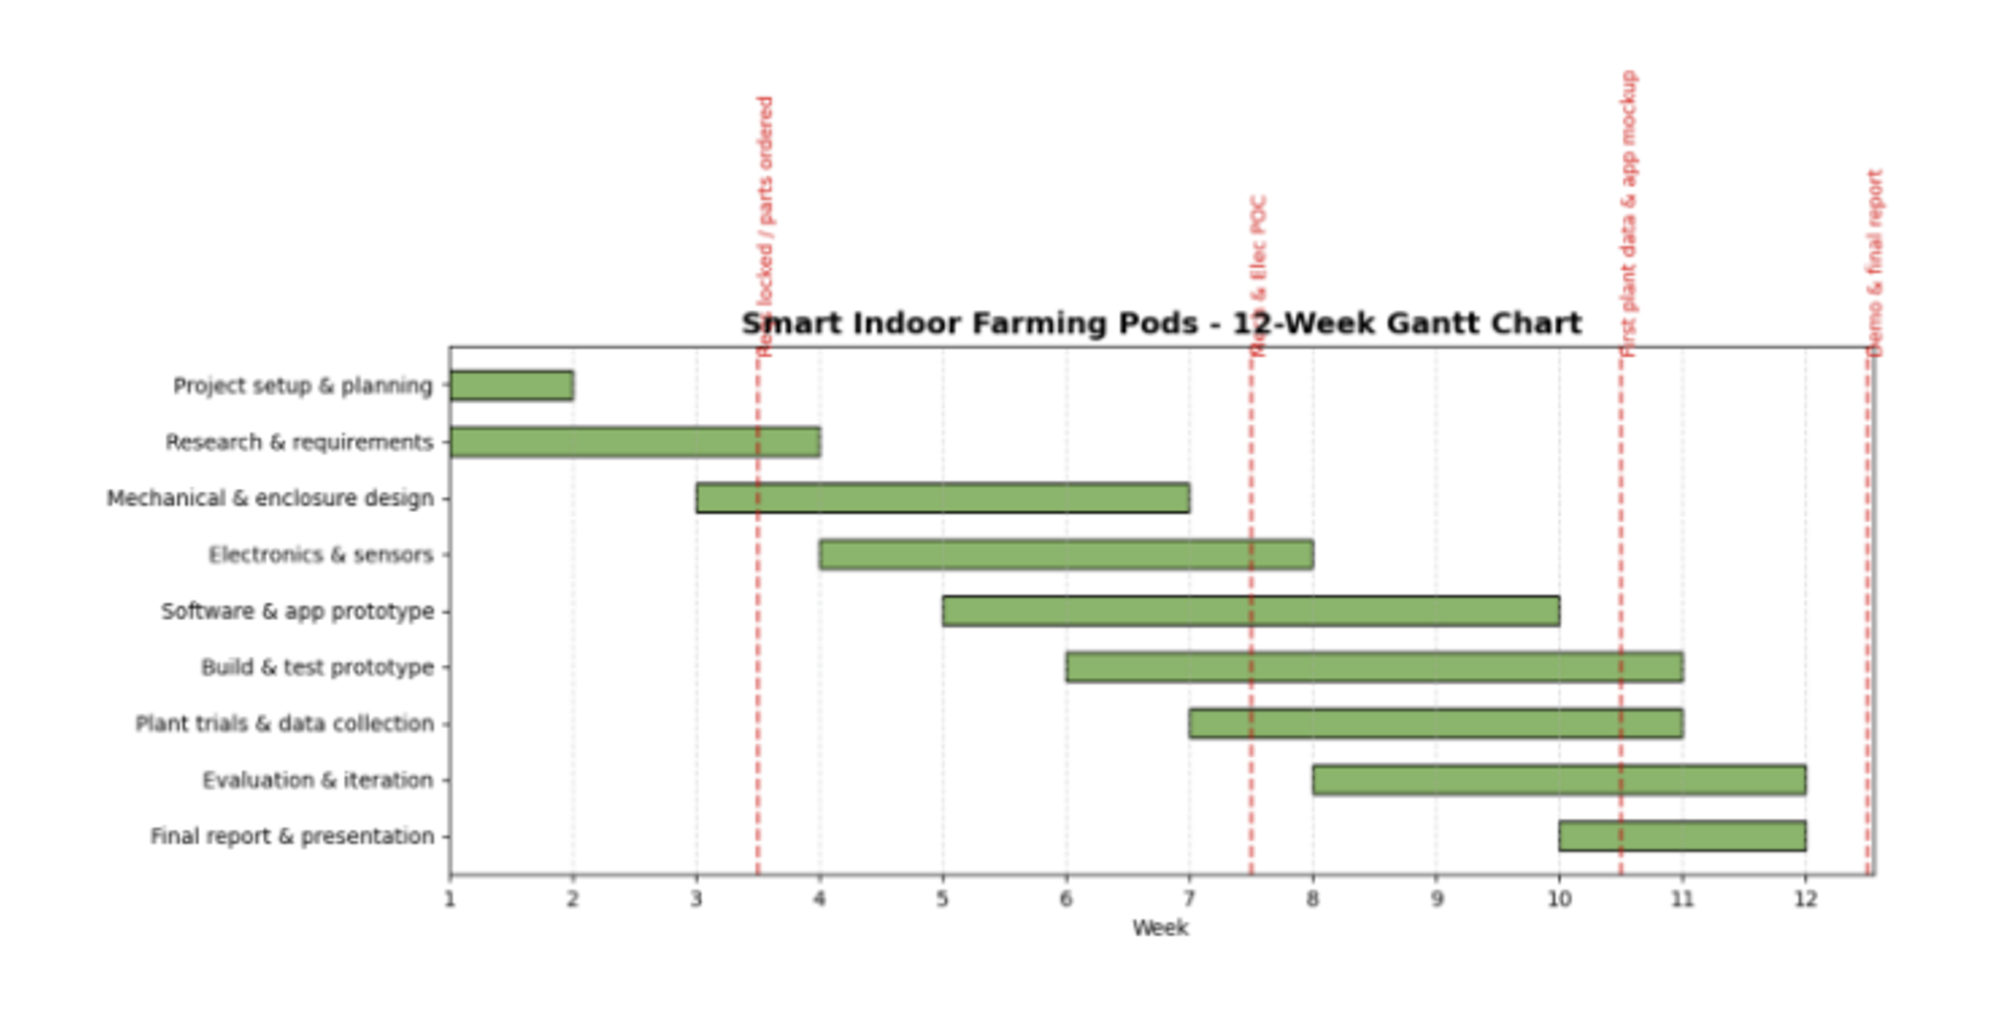
Implementation Plan
Phase 1 (Weeks 1-3)
Market Research, feasibility study, technical requirements defined
Phase 2 (Weeks 4-6)
Pod CAD design, sensor selection, wiring plan.
App mockups and basic interface structure.
Phase 3 (Weeks 7-9)
Prototype build or mockup of pod.
Sensor testing and initial app data display
Phase 4 (Weeks 10-12)
Integrated testing (hardware + app), user feedback, improvements
Final report and presentation

Slide 5
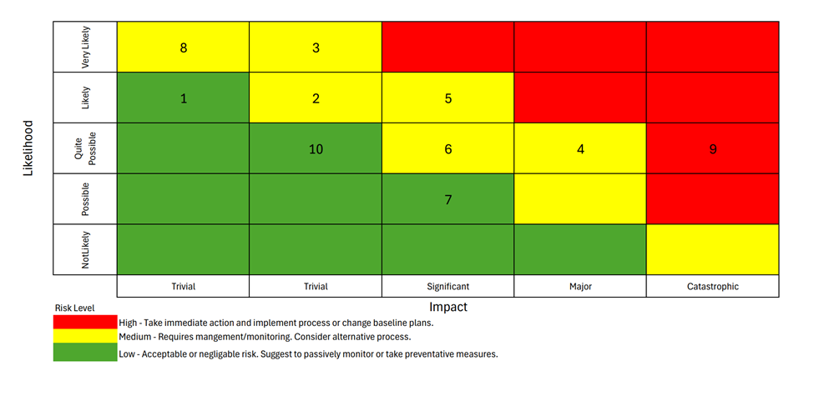
Risk Analysis
Top Risks Identified
Sensor delays/fault components
Microcontroller/electronics issues
Prototype rework or redesign
Connectivity failures (IoT/Wi-Fi)
App integration issues
Plant growth variability
User experience/ usability problems
Budget overruns
Data loss/ logging failures
Team availability issues
Quantitative Tools
FMEA with Risk Priority Numbers (RPN) showed that 3. Prototype Rework/Redesign, 4. Connectivity Issues, and 5. App Integration Failure are the critical areas to focus on mitigating risk efforts on.

Slide 6
Monitoring & Control
Roles and Responsibilities
PM tracks schedule, milestones, issues.
Hardware Lead/Software Lead monitor build and app integration
QA Lead conducts testing and performance validation
Finance Lead monitors expenditures and budget drift.
Monitoring Tools
Trello/MS Project
Gantt Charts
Centralized documentation repositories
Risk/Issue log in spreadsheets
Reports & Checkpoints
Progress Reports 1-4 at major phase completions
Midpoint Interim Report
Final Report at project completion
KPIs
Schedule adherence within +/-5%
Sensor accuracy > 95%; App command success rate > 95%
Plant survival: >/ 4-5 plants thriving in pilot testing
User Satisfaction: >/80%
Budget Compliance within +/- 10%
Risk mitigation closed within alloted times
Earned Value – Critical Ratio
CR = (Actual Budget / Budgeted Progress) x (BCW / ACW)
CR > 1: ahead of plan; CR < 1: behind plan

Slide 7
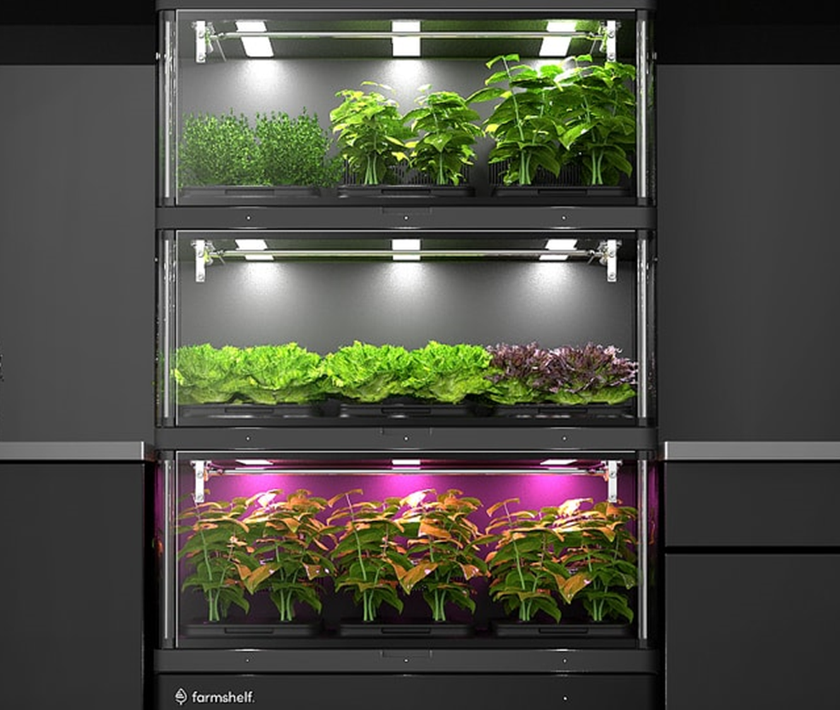
Financial Plan
Total estimated cost: ~$4,648
Prototype budget: $260–$520
Material + tools: $310
Personnel: $4,338
Break-even: 49 pods
Estimated budget: $185–$455 for essential hardware and software tools

Slide 8
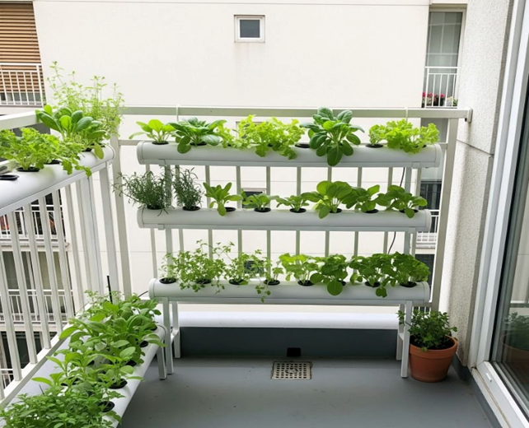
Resource Allocation – Team Roles & Responsibilities
Project Manager — Tracks milestones, consolidates reports, escalates risks.
Hardware Lead — Oversees sensor development, pod design, and electronics integration.
Software Lead — Handles app development, functionality testing, user feedback adjustments.
QA Lead — Conducts testing, ensures usability criteria, documents results.
Finance Lead — Budget tracking, cost reporting, procurement decisions.
Tools used — MS Project, Trello, OneDrive, Google Drive, Risk log spreadsheet.

Slide 9

Conclusion – Indoor Farming Pods
Purpose: Delivers a Smart modular indoor farming for urban homes, piloting in Boston
Pods will utilize sensors to monitor humidity, light, and water for automizing plant health and growth
Overall system has potential for mitigating risk, reducing costs, and a scalable foundation for a user-friendly indoor growing solution

